Slide 1
AI-Based Tool for Preliminary Diagnosis of Dermatological Manifestations
CSE7101- Capstone Project
Review-1
Batch Number : CSG_16
Under the Supervision of,
Dr. Harish Kumar K.S
Assistant Professor
School of Computer Science and Engineering
Presidency University
Roll Number | Student Name
20221CSG0020 | S MOHAMMED AFFAN
20221CSG0059 | KARTHIK MP
20221CSG0092 | CHAITHRA C
Name of the Program: CSG-Computer Science & Technology(AI ML)
Name of the HoD: Dr.Saira Banu
Name of the Program Project Coordinator: Dr. H M Manjula
Name of the School Project Coordinators: Dr. Sampath A K , Dr. Geetha A

Slide 2
Problem Description
Category : Software
Skin diseases are among the most common global health concerns, ranging from minor infections to chronic disorders and cancers, where early and accurate diagnosis is critical. However, access to dermatologists remains limited due to specialist shortages and high patient loads. To address this, the project proposes an AI-based tool that leverages image processing and machine learning to provide preliminary dermatological diagnosis. The system analyzes images of skin lesions and generates possible diagnoses with confidence scores and visual explanations, ensuring transparency. Designed as a decision-support tool, it enables early detection, risk prioritization, and timely referral rather than replacing dermatologists. A lightweight CNN with transfer learning ensures efficiency and accuracy across diverse skin tones. Finally, deployment as a web/mobile prototype makes it suitable for tele-dermatology and community healthcare, improving accessibility while reducing the burden on specialists.

Slide 3
Problem Statement_PSCS_49
Skin diseases present a major healthcare challenge due to their high prevalence, visual complexity, and similarity across conditions, which often makes accurate diagnosis difficult. While AI has shown great promise in medical image analysis, most existing solutions in dermatology are either disease-specific, limited in scope, or unable to adapt to diverse populations and skin tones. This leads to reduced reliability and restricts their application in real-world scenarios. There is a clear need for a generalized, inclusive, and explainable system that can assist in the preliminary identification of dermatological conditions. The proposed project directly addresses this gap by creating an AI-based diagnostic tool capable of supporting patients and healthcare providers in early and accurate decision-making.

Slide 4
Objectives
The project titled AI-Based Tool for Preliminary Diagnosis of Dermatological Manifestations focuses on developing an intelligent system to assist in the early identification of skin diseases using image processing and machine learning.
The primary objective is to analyze images of skin lesions, rashes, or other dermatological conditions using advanced image processing and machine learning techniques. The tool will generate possible diagnoses along with confidence scores, thereby supporting both patients and healthcare providers. By enabling timely detection and prioritization of cases, the system aims to reduce diagnostic delays and enhance healthcare outcomes. This project is intended as a decision-support system and not as a replacement for dermatologists, ensuring safe and ethical application in medical practice.

Slide 5
Background and Related work for title Selection
Skin diseases are among the most widespread health issues worldwide, and early detection is essential to avoid serious complications. Unfortunately, timely access to dermatologists is often limited due to high patient loads and a shortage of specialists. With the advancement of Artificial Intelligence, particularly deep learning models such as Convolutional Neural Networks (CNNs), significant progress has been made in medical image analysis. For instance, Esteva et al. (2017) demonstrated that AI can classify skin cancer images with accuracy comparable to expert dermatologists. Publicly available datasets like HAM10000 and ISIC, along with methods such as Grad-CAM, have enabled training of more generalized and interpretable models. However, most existing approaches focus on specific diseases or fail to generalize across different conditions and skin tones. To address this gap, the proposed project aims to build an AI-based tool for preliminary diagnosis of dermatological manifestations that is more generalized, accessible, and supportive.

Slide 6
Proposed Methodology
The proposed system will begin with the collection of a large and diverse dataset of dermatological images covering multiple skin conditions and tones. Image preprocessing techniques will be applied to enhance quality, remove noise, and normalize variations. A deep learning architecture, particularly Convolutional Neural Networks (CNNs), will be employed to extract features and classify skin manifestations. Transfer learning with pre-trained models such as ResNet or EfficientNet will be explored to improve accuracy and reduce training time. The system will also incorporate explainable AI techniques such as Grad-CAM to provide interpretable predictions along with confidence scores. Finally, the tool will be deployed as a user-friendly web or mobile application, ensuring accessibility for both healthcare professionals and patients.

Slide 7
Innovation or Novel Contribution
The novelty of this project lies in its focus on developing a generalized AI-based tool capable of diagnosing a wide range of dermatological manifestations rather than being restricted to a single disease. Unlike existing systems, the tool will be designed to handle variations across different skin tones, age groups, and conditions, making it more inclusive and reliable. It integrates advanced deep learning techniques with explainable AI methods to provide confidence scores and visual interpretations, helping users and healthcare providers trust the predictions. The system is intended to function as a decision-support tool rather than a replacement for dermatologists, ensuring safe adoption in real-world healthcare. Moreover, by leveraging accessible platforms such as mobile or web applications, it extends dermatological support to both urban and rural populations. This combination of inclusivity, explainability, and accessibility makes the project a significant improvement over existing solutions.

Slide 8
Analysis of Problem Statement
Technology Stack Components
Programming Languages: Python (for AI/ML models), JavaScript/React (for web)
AI/ML Libraries: TensorFlow / PyTorch, Keras, OpenCV (for image preprocessing)
Frameworks: Flask / FastAPI (for backend)
Databases: MySQL / MongoDB (for patient data and model outputs)
Cloud Platforms: AWS / Google Cloud / Azure for hosting and model deployment
Visualization: Grad-CAM or LIME for explainable AI heatmaps

Slide 9
Analysis of Problem Statement
Software Requirements
OS: Windows / Linux / macOS (for development)
Development Tools: Jupyter Notebook, PyCharm / VS Code
Libraries: TensorFlow, PyTorch, OpenCV, scikit-learn, NumPy, Pandas, Matplotlib
Web Tools: Node.js, React.js (for frontend), Flask/FastAPI (for backend APIs)

Slide 10
Github Link
https://github.com/Stu-Affan/Capstone-Project/tree/main

Slide 11
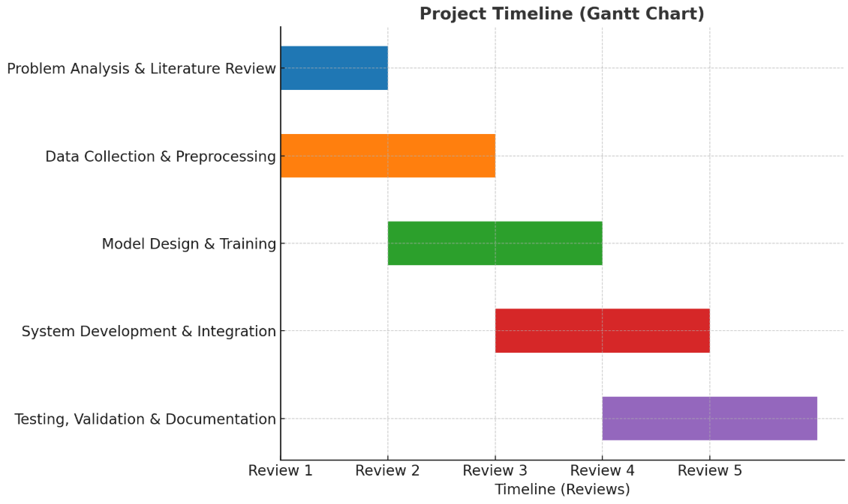
Timeline of the Project (Gantt Chart)

Slide 12
References (IEEE Paper format)
[1] A. Esteva, B. Kuprel, R. A. Novoa, J. Ko, S. M. Swetter, H. M. Blau, and S. Thrun,
“Dermatologist-level classification of skin cancer with deep neural networks,” Nature, vol. 542, no. 7639, pp. 115–118, Feb. 2017.
https://doi.org/10.1038/nature21056
https://www.andreesteva.com/assets/nature_skincancer.pdf
[2] P. Tschandl, C. Rosendahl, and H. Kittler, “The HAM10000 dataset, a large collection of multi-source dermatoscopic images of common pigmented skin lesions,” Scientific Data, vol. 5, p. 180161, 2018.
https://www.nature.com/articles/sdata2018161
[3] Balazs Harangi , “Skin lesion classification with ensembles of deep convolutional neural networks,” Journal of Biomedical Informatics, vol 86, pg.25-32, Oct 2018.
https://doi.org/10.1016/j.jbi.2018.08.006

Slide 13


